Slide 1
Search Engine
Gang of Four:
Vishesh Dosaj
Kshitij Deshpande
Rajkiran G
Ashwin Jagarapu

Slide 2
Topics
Problem Statement
Vector Space Model
Cosine Similarity
TF-IDF
Solution
Output
Future Scope
References
Q&A

Slide 3
Problem Statement
Given a set of 2000 documents.
Assumption made: Documents are in the format of Text files.
User enters a text.
Ranking the documents based on the query

Slide 4


Vector Space Model
Document Vector
Key idea is to transform a search from a linguistic problem into a geometric problem.
Documents and queries are represented as vectors:
corresponds to the different terms in the
dictionary
here is some function that measures the importance of the term t
Query Vector

Slide 5
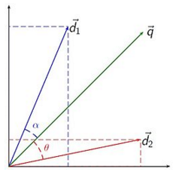



Cosine Similarity
The deviation between the document vector and the query vector
Its easier to calculate the cosine of the angle between vectors
is the norm of the vector d2 and is the norm of the vector q
If cosine value is 0 then the vectors are orthogonal and have no match
So smaller the angle, the more relevant the document is to the query

Slide 6
TF-IDF
Term Frequency – Inverse Term Frequency
The weight of a term that occurs in a document is proportional to the term frequency
The specificity of a term can be qualified as an inverse function of the number of documents in which it occurs

Slide 7
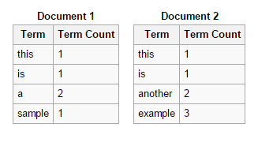


TF-IDF(Example)

Slide 8
Solution
Step 1: Extract all the files from the folder.
Step 2: For each document, split, strip, tokenize and stem the document data.
Step 3: Create the document vectors.
Step 4: Fetch the input query from the user.
Step 5: Repeat Step 2 and Step 3 to create the query vector.
Step 6: Remove the irrelevant documents and calculate the cosine similarity on the relevant documents.
Step 7: Apply TF-IDF algorithm to the vectors.
Step 8: Display the final results in a sorted order.

Slide 9
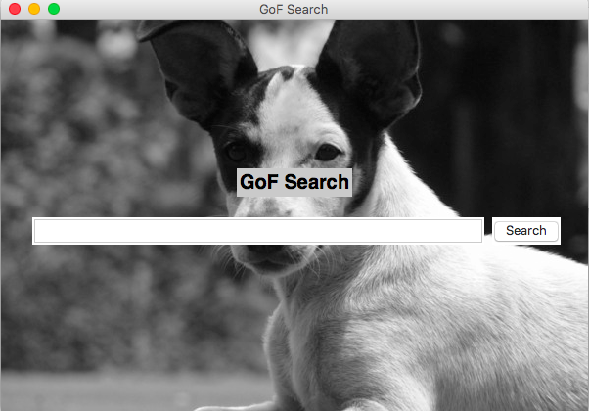
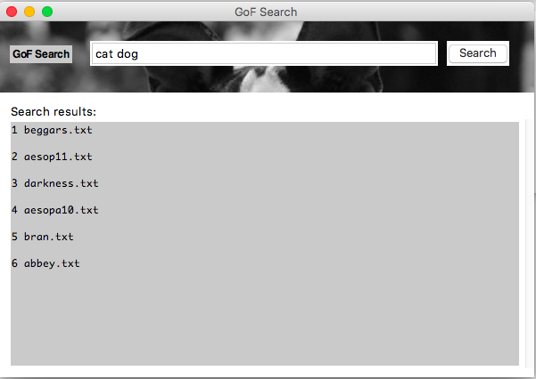
Output

Slide 10
Future Scope
Integrating Data using MongoDB
Internal indexing implementation when new files are loaded
Applying Latent Semantic Analysis on the TF-IDF results to improve performance
Using Neural networks or Lanczos method instead of linear processing of documents

Slide 11
References
https://janav.wordpress.com/2013/10/27/tf-idf-and-cosine-similarity/
http://aimotion.blogspot.com/2011/12/machine-learning-with-python-meeting-tf.html
http://www.csee.umbc.edu/~ian/irF02/lectures/07Models-VSM.pdf
https://en.wikipedia.org/wiki/Vector_space_model
https://en.wikipedia.org/wiki/Tf%E2%80%93idf
http://nlp.stanford.edu/IR-book/information-retrieval-book.html
http://tartarus.org/martin/PorterStemmer/python.txt

Slide 12

#GoFSearch
Go figure :P

